Slide 1

Notes:
Hello - our team of changemakers is called Echo.
We chose this name so we can get the message of our work across the world. Constantly reverberating our positive message of hope.

Slide 2


Team Echo
Fatimah Khan, Destiny Moan, Vilim Boroša, Rabiah Ahmad
With thanks to the support and guidance of the Young Leaders’ Committee and Mentors
Notes:
Hello - our team of changemakers is called Echo. Introduce each of us - names, places. We chose the name Echo because we wanted our message of ending poverty to resonate throughout the world.

Slide 3

Which Sustainable Development Goal did we opt for and why?
Notes:
(Fatimah) We chose to focus our project on SDG 1 - No Poverty, because we believe that there’s no excuse for the fatal cycle to continue. One of our primary motives were that poverty is interconnected with many other key goals for overall sustainability such as climate action, education or innovation and infrastructure. We believe that we can tackle issues of poverty by improving infrastructure and working on challenges with access to resources: ultimately, we believe that ending poverty will be the key to promoting sustainable development worldwide.

Slide 4
What was the need and how did we identify it?
We investigated specific indicators of the goal and how unstable economic activity perpetuates the cycle of poverty
Our research journey and our personal connections and understandings brought us to the agricultural economy within Croatia
Notes:
Which element of the goal did we focus in on and brief explanation why (will correlate with what we have already said):
Research of different patterns of poverty especially amongst young people
Why we chose to research the places we did
- we need to be as specific as possible – what makes our project special – what is the occurring problem arising in all the countries investigated? – introduction to the project as a whole, finish should be a description in one sentence, a motto grasping the very core of the project – possibly (building the economy by seeing and watering the potential already there, only thing needed for success is leadership/direction and we are bringing it in heaps) – meaning - we know, because of our research and problem-solving skills, where to strike to solve economic problems of the area we are helping
My speech
We focused on where the unstable economy perpetuates the cycle of poverty. By discussion and explorative research of inhabited economic growth we identified the the most affected country in this sector of poverty. Our research journey and personal connections led us to Croatia. We believe that there are much effective ways to tackle the economic instability of small businesses which then prevents them going into a deeper financial problem.

Slide 5

PROBLEM - A way to help OPGs (small green foods companies) failing due to the lack of market exposure and no knowledge of business management
POPULATION - small businesses (OPGs) in the area near the Zagreb city
OUTCOME - decrease of Croatia's imports-exports deficit in agriculture for at least 0.7 bn euro during the period of 2 years (indicating the rise of economic activity of the country)
A way to help small businesses (OPGs) near the city of Zagreb failing due to the lack of market exposure and knowledge of business management, in order to decrease the imports-exports deficit for at least 0.7 bn euro in Croatia's agriculture sector during a 2 year period.
Notes:
(Read out Needs Statement)

Slide 6

Croatian economy
Abundant Panonian plain –
54% of territory below 200m
76.1% (862.302,9 ha) –
OPGs (obiteljsko poljoprivredno gospodarstvo)
– 96,8% of all farmers
- Biggest hub is in Zagrebačka županija (14 295 farmers)
Source: „Zeleno izvješće 2018.”
Notes:
Graphs representing everything said

Slide 7
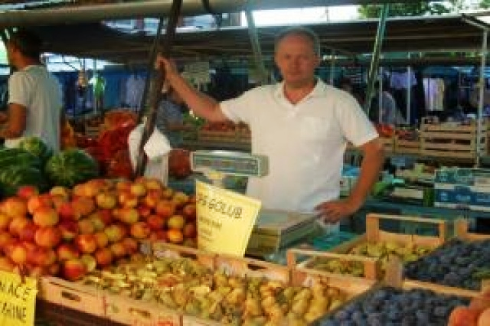

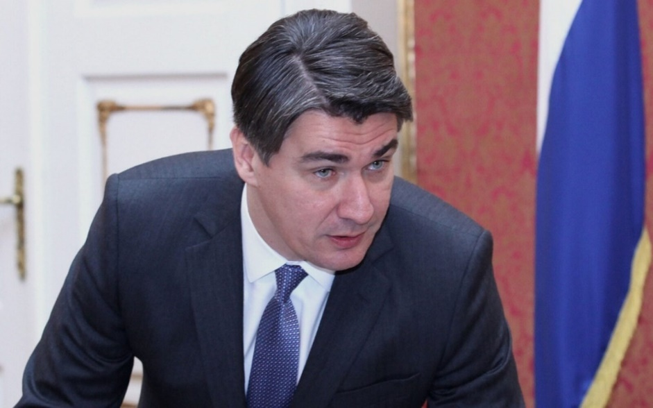

Farmers are poor, market is unsustainable…
Number of OPGs
162 966 – November 2020.,
source: komora.hr
Import of foods
1258 mil. - 2020., source: dzs.hr
Deficit – 1.4 billion euro
Notes:
Okay, here we are. The main problem slide regarding Croatia. Main point is here. Abundance of OPGs, economy doesn’t incorporate them and is failing. The upper picture is of utmost importance, it clearly shows how OPGs currently operate (like in middle ages), it’s on us to show this to the investors.

Slide 8
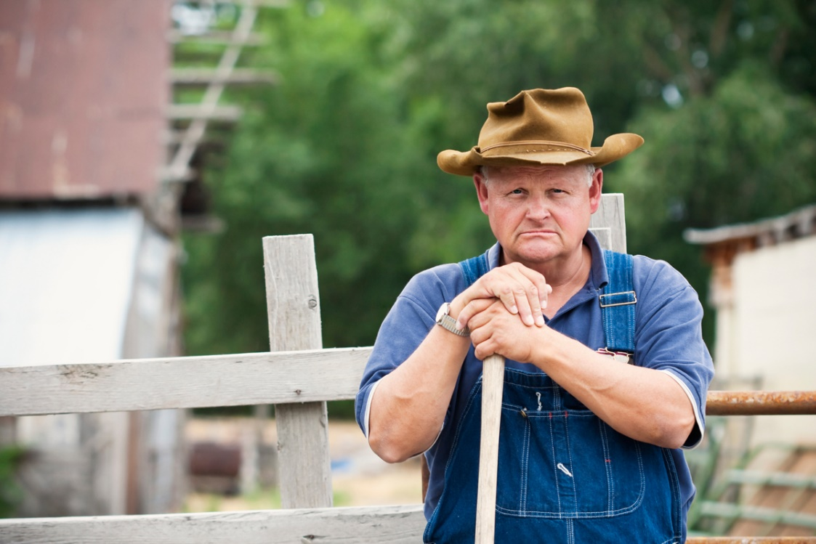
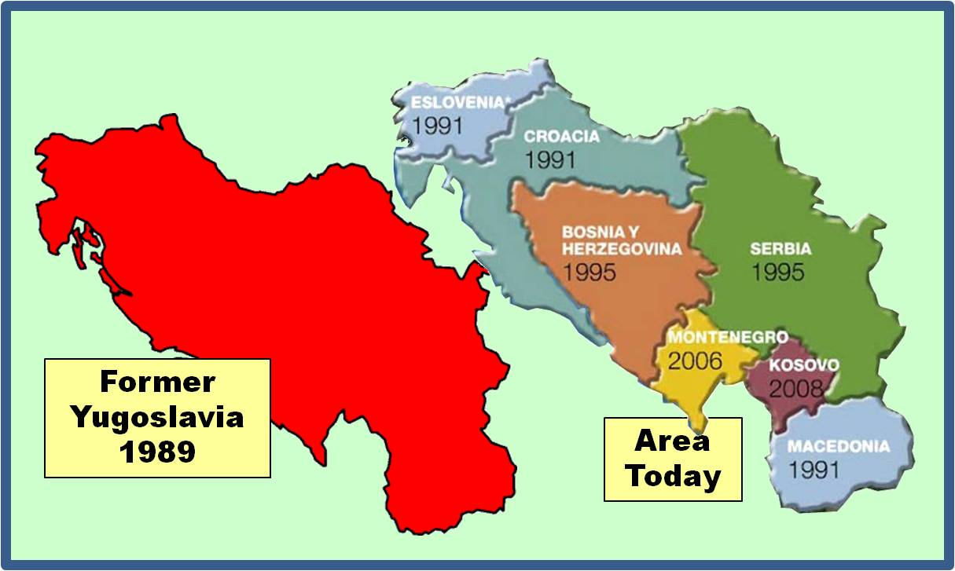
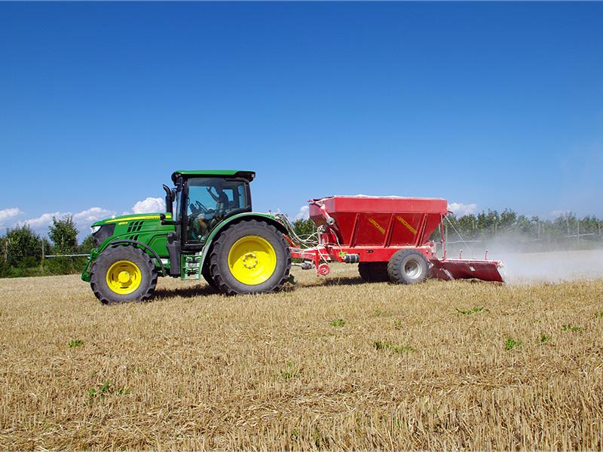
Historical overview
Legacy of Yugoslavia
Government used to buy out all the products from the farmers directly
Transition to the capitalistic market never truly happened

Slide 9
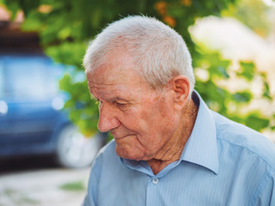
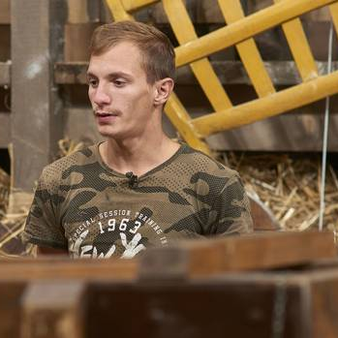
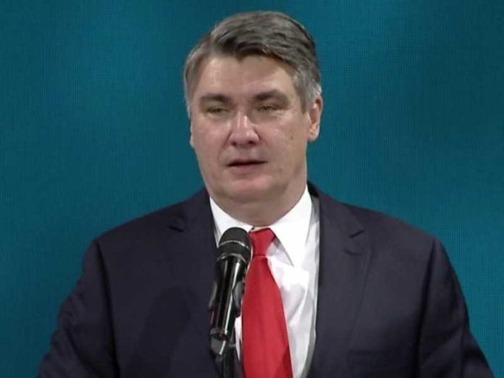
Branko
Matej
Zoran
Notes:
Story begins, we have three main representatives of groups of people affected by the problem we are trying to solve. Matej is a Croatian farmer (real-life farmer; sort of local celebrity in Croatia as of this year, has a tragic backstory, ideal representative of OPG owner), Branko is a representative of the older OPG owners population and Zoran Milanovic is Croatia’s president and the umbrella representative of the major economic processes in Croatia, through him we will present why economy is in bad shape and why it should be sustainable

Slide 10
Building the economy by watering the potential already there, the only thing needed for success is direction, and we are bringing it in heaps.
Notes:
(Fatimah) This is similar to the fish analogy:
Instead of giving a man fish, teach him how to fish.

Slide 11


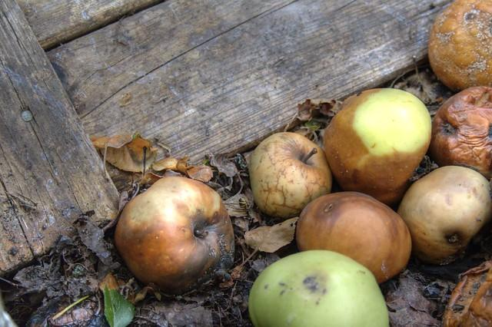




“Svima je jasno kako hrvatskim poljoprivrednicima trebaju stručni savjeti tehničke i tehnološke te financijsko-pravne prirode” – 26.11.2020. ; HPK
No market exposure
=
no revenue
Depression and unwillingness to pursue growth goals
Waste of food and land potential
Isolation from the market
=
no dialogue and learning curve
Only 13.11% of young farmers – 2020. (Croatian agriculture statistics)
Notes:
Here are main problems arising from our problem statement

Slide 12
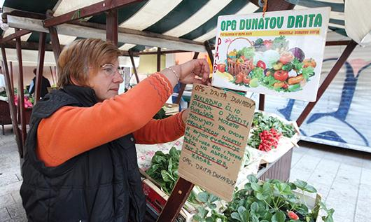
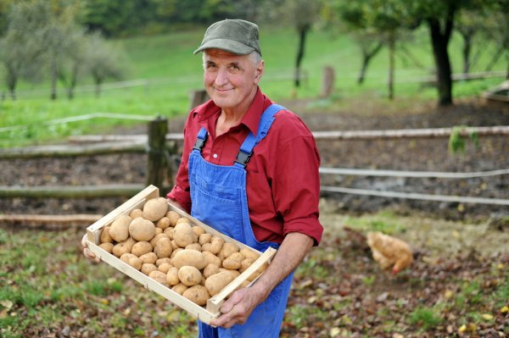
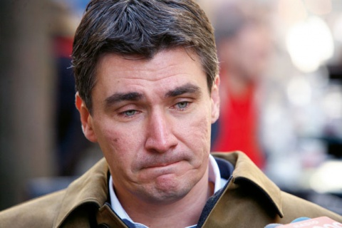

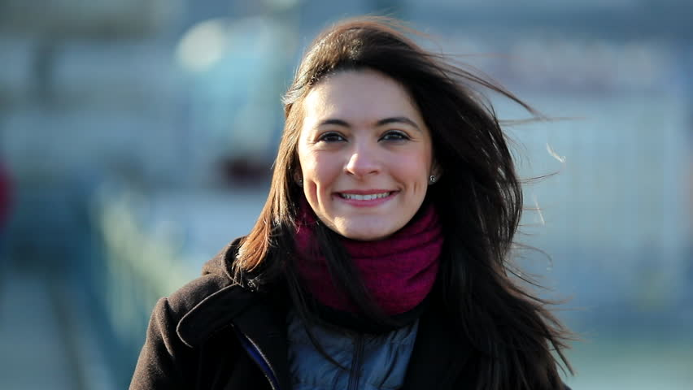

Notes:
Visual representation of our platform’s impact, focus of the speaker should be on why and how everyone affected becomes happy because of our agenda, introduction to the platform idea

Slide 13

What is being done already and why us?
Investments
Startups
Fuelling economic growth within Europe
Connecting OPG communities
Concentration on local economy with interpersonal connections and business education
Technology, sustainability, long-term growth
Farmer-led

Slide 14
What will we do?
Development of the online platform connecting OPGs
First cycle of collective input in the market
Second cycle of collective input in the market
1.
3.
5.
…
2.
4.
Redesigning of the platform (improving efficiency, adding features, connecting with foreign resellers and technology experts)
Connecting with main resellers in Croatia; design and publication of marketing materials
Notes:
Timeline of the project, focus on where would the money go (development of the platform, marketing)

Slide 15
Our platform in a nutshell
First goal
Monthly fee
Connection with other OPGs and the government
HPK (Hrvatska poljoprivredna komora)
(Croatian agricultural agency)
1.
Second goal
FREE
Connection with resellers
Spar hrvatska d.o.o.
DM drogerie markt d.o.o. Konzum d.o.o.
2.
Third goal
Additional fee
Connection with experts in economics and technology
3.
Notes:
Okay, so here is the brief description of the platform presented through three goals with their corresponding description and key players. We also need revenue streams, I believe the price for first goal as presented in thep slide above should be symbolic with our main revenue stream being additional fee. First and second goal would also serve as great bait-hook marketing which is extremely useful.

Slide 16
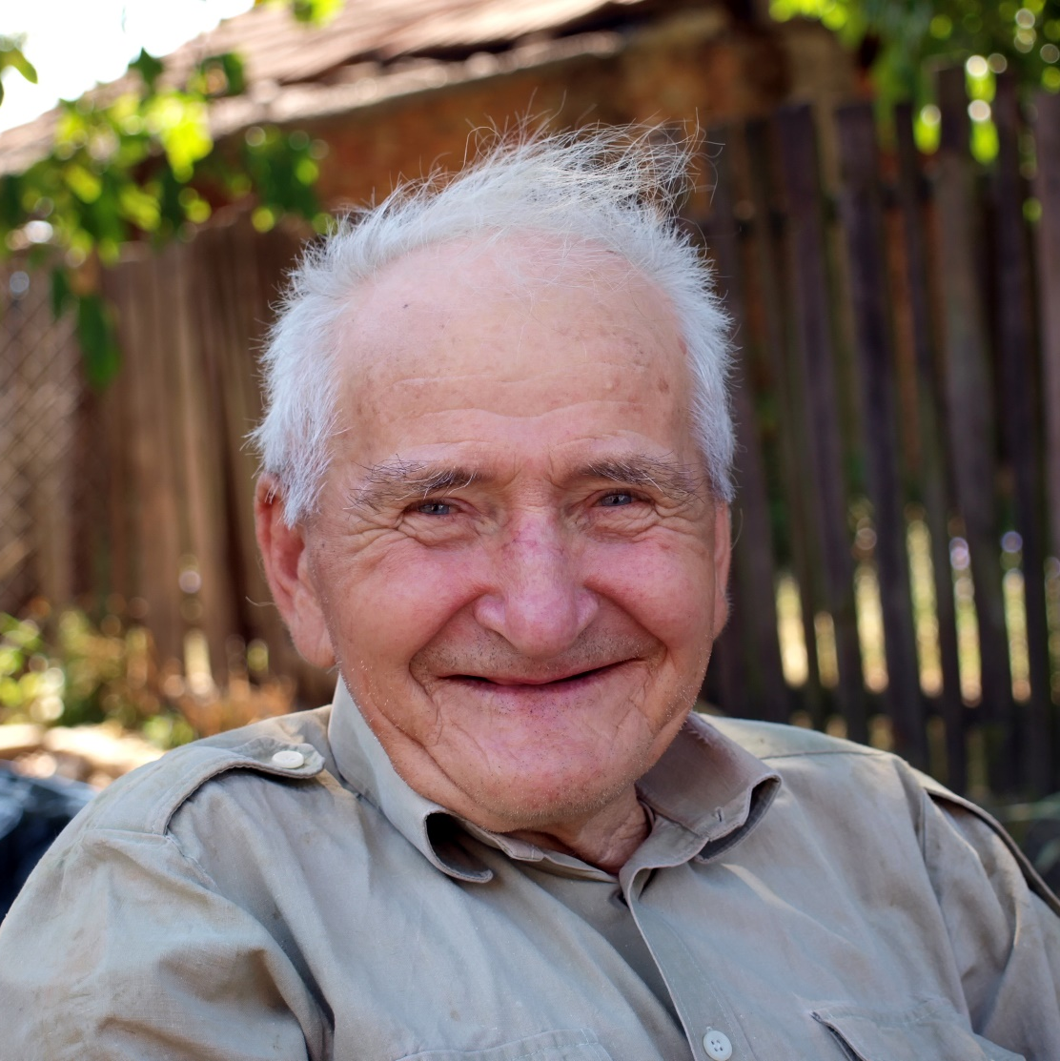
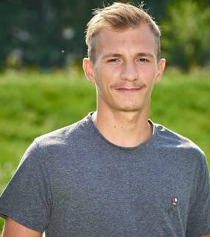
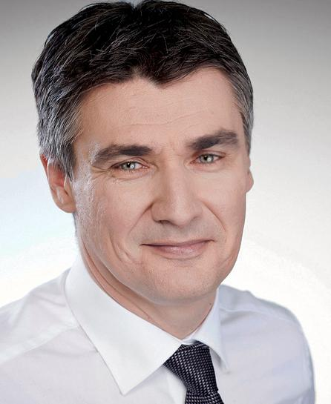
Notes:
End of story, everyone affected is happy

Slide 17
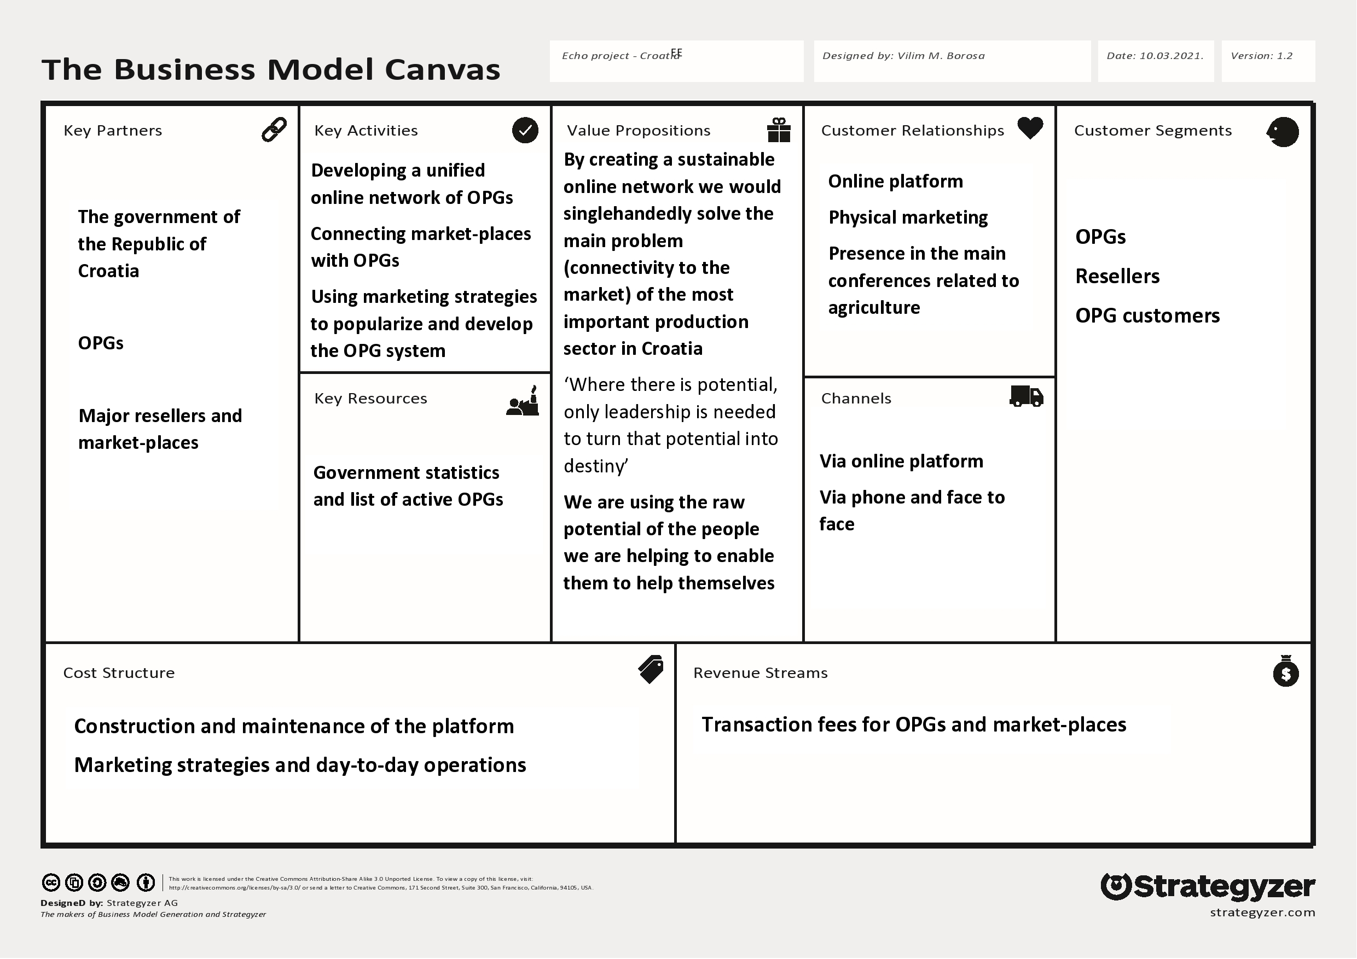

Slide 18
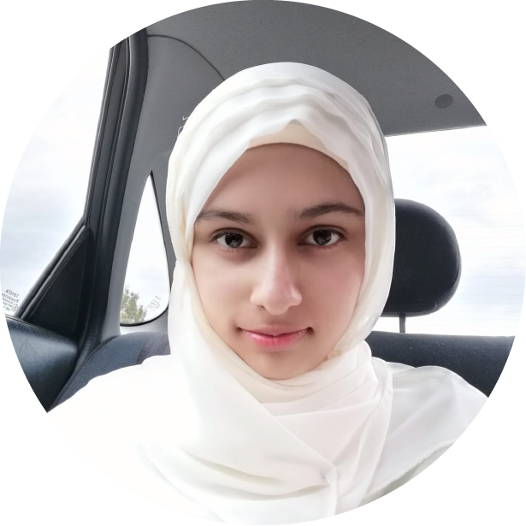
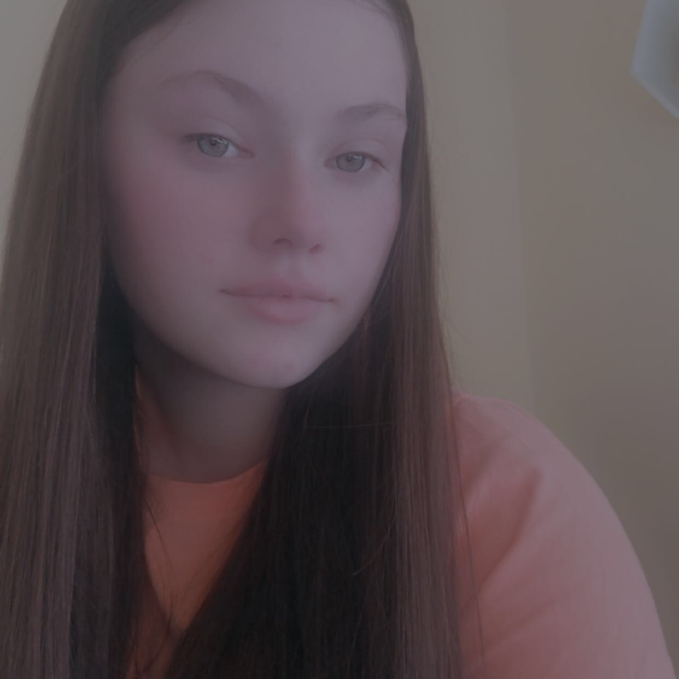
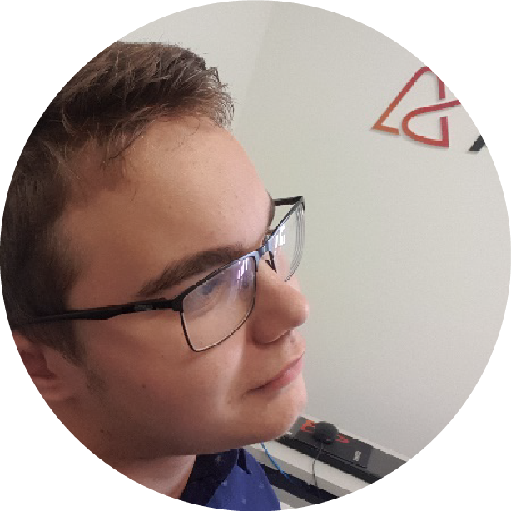



The Team
Fatimah Khan
Destiny Moan
Vilim Borosa
Rabiah Ahmad
Developer/Core Team
Developer/Core Team
Developer/Core Team
Developer/Core Team
Notes:
We should have a detailed description of ourselves, investors must fully understand who we are, our main past projects should be expressed in logo form under our pictures for additional credibility

Slide 19
Thank you for listening, we appreciate your time!
We are available for additional contact through the following platforms:
Email: echoforchange2021@gmail.com
Instagram: @echoforchange2021
Find us on LinkedIn:
Fatimah Khan
Destiny Moan
Rabiah Ahmad
Vilim Boroša

